Slide 1
Chapter 3
How to make a web app responsive with Bootstrap

Slide 2
Objectives (part 1)
Applied
Use any of the Bootstrap CSS classes and components presented in this chapter in your web apps.
Use LibMan to add the NuGet packages for client-side libraries such as Bootstrap and jQuery to a project.
Knowledge
Explain what responsive web design is and how it’s implemented using Bootstrap.
Describe how the Bootstrap grid system works.
Describe how to use the Bootstrap CSS classes to format and align labels, text boxes, and buttons within a form.
Describe how to use the Bootstrap CSS classes to format images, HTML tables, and text.

Slide 3
Objectives (part 2)
Describe how to use Bootstrap components such as jumbotrons, button groups, icons, badges, button dropdowns, list groups, alerts, breadcrumbs, navs, and navbars.
Describe how to use Bootstrap CSS classes to provide context.
Describe how to use Bootstrap CSS classes to adjust margins and padding.

Slide 4
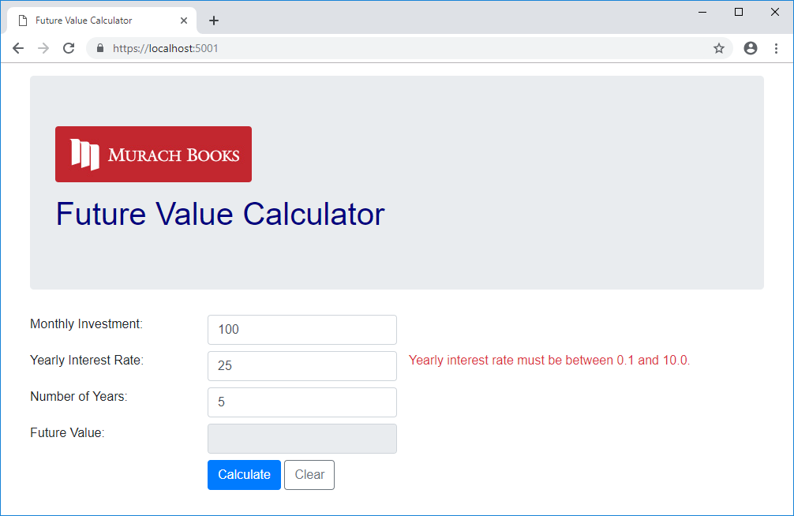
The Future Value app in a desktop browser

Slide 5
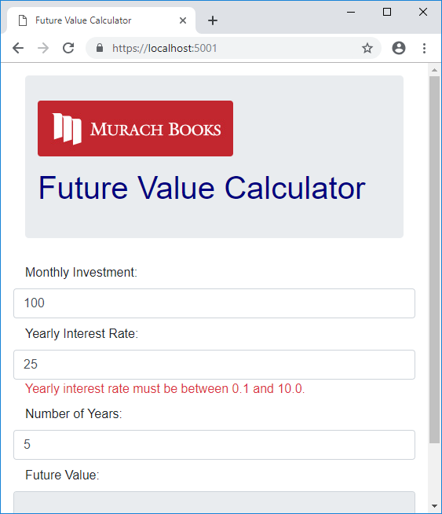
The Future Value app in a tablet browser

Slide 6
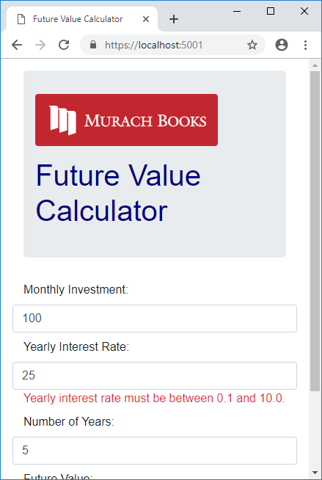
The Future Value app in a phone browser

Slide 7
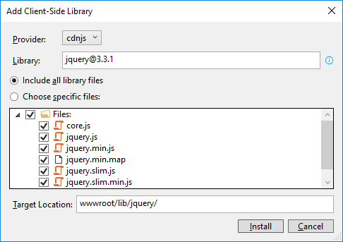
The dialog box for adding the jQuery library

Slide 8
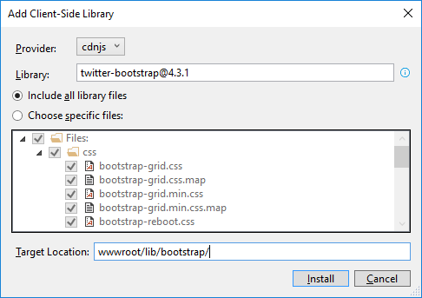
The dialog box for adding the Bootstrap library

Slide 9
How to add the Bootstrap and jQuery libraries
Start Visual Studio and open a project. In the Solution Explorer, expand the wwwroot/lib folder and delete any old Bootstrap or jQuery libraries.
In the Solution Explorer, right-click on the project name and select the Add→Client-Side Library item.
In the dialog box that appears, type “jquery@”, select “3.3.1” from the list that appears, and click the Install button.
Repeat steps 2 and 3 for the library named “twitter-bootstrap@4.3.1”, but change the target location to “www/lib/bootstrap”.
Repeat steps 2 and 3 for the library named “popper.js@1.14.7”.
Repeat steps 2 and 3 for the library named “jquery-validate@1.19.0”.
Repeat steps 2 and 3 for the library named “jquery-validation-unobtrusive@3.2.11”.

Slide 10
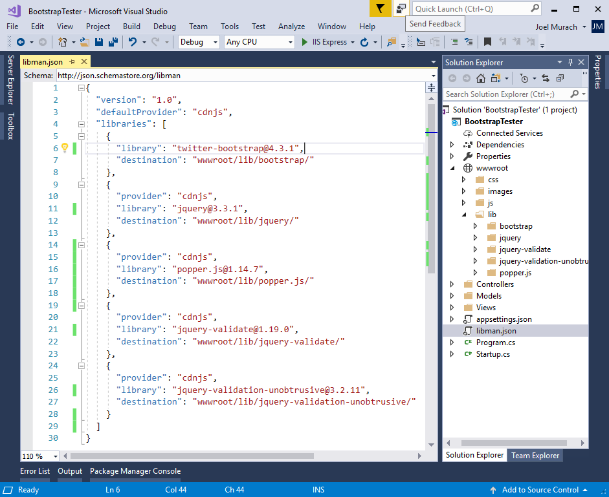
The libman.json file for the client-side libraries

Slide 11
A Razor layout that enables client-side libraries
<!DOCTYPE html>
<html>
<head>
<meta name="viewport" content="width=device-width" />
<title>@ViewData["Title"]</title>
<link rel="stylesheet"
href="~/lib/bootstrap/css/bootstrap.min.css" />
<link rel="stylesheet" href="~/css/custom.css" />
<script src="~/lib/jquery/jquery.min.js"></script>
<script src="~/lib/popper.js/popper.min.js"></script>
<script src="~/lib/bootstrap/js/bootstrap.min.js"></script>
<script src="~/lib/jquery-validate/
jquery.validate.min.js"></script>
<script src="~/lib/jquery-validation-unobtrusive/
jquery.validate.unobtrusive.min.js"></script>
</head>
<body>
@RenderBody()
</body>
</html>

Slide 12
An extra directory that may be included by the MVC template
<link rel="stylesheet"
href="~/lib/bootstrap/dist/css/bootstrap.min.css" />

Slide 13
The URL for the Bootstrap documentation
https://getbootstrap.com/docs/
Valid Bootstrap class values
container
container-fluid
row
col
col-size-count
offset-size-count
Valid size values
lg
md
sm
(none)

Slide 14
Two columns that are automatically sized
<div class="col">Column 1</div>
<div class="col">Column 2</div>
An element that spans four columns on medium and large screens
<div class="col-md-4">This element spans four columns</div>
An element that spans 4 columns on medium screens and 3 on large
<div class="col-md-4 col-lg-3">
This element spans three or four columns
</div>
An element that is moved one column to the right on medium screens
<div class="col-md-4 offset-md-1">
This element is offset by one column
</div>

Slide 15
The HTML for a grid
<main class="container">
<div class="row">
<div class="col-12">Column 1</div>
<div class="col-12">Column 2</div>
</div>
<div class="row">
<div class="col-md-4">Column 1</div>
<div class="col-md-8">Column 2</div>
</div>
<div class="row">
<div class="col-md-4 col-sm-6">Column 1</div>
<div class="col-md-8 col-sm-6">Column 2</div>
</div>
</main>

Slide 16
Custom CSS classes that override the Bootstrap CSS classes
.row { /* custom row styles */
margin-bottom: 0.5rem;
}
.row div { /* custom column styles */
border: 1px solid black;
padding: 0.5rem;
background-color: aliceblue;
}

Slide 17
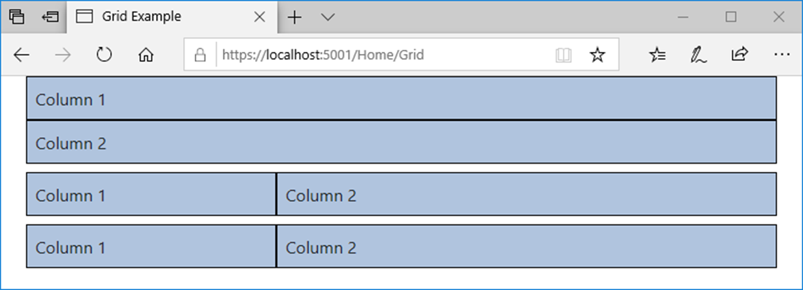
The Bootstrap grid on a medium screen

Slide 18
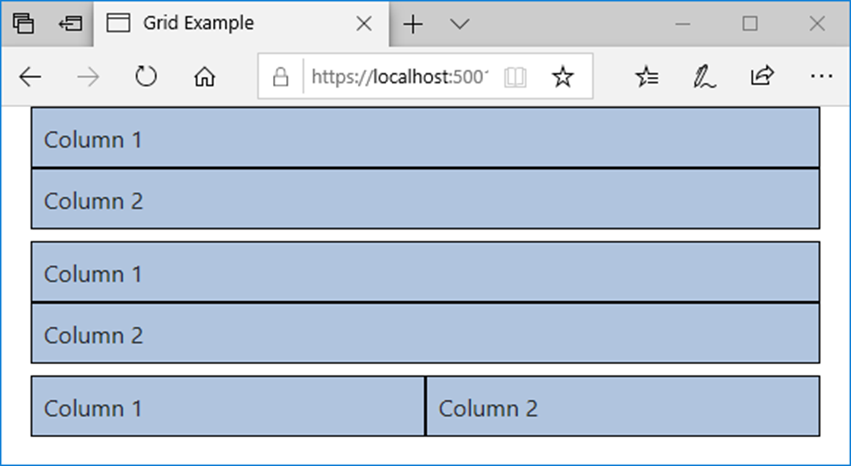
The Bootstrap grid on a small screen

Slide 19
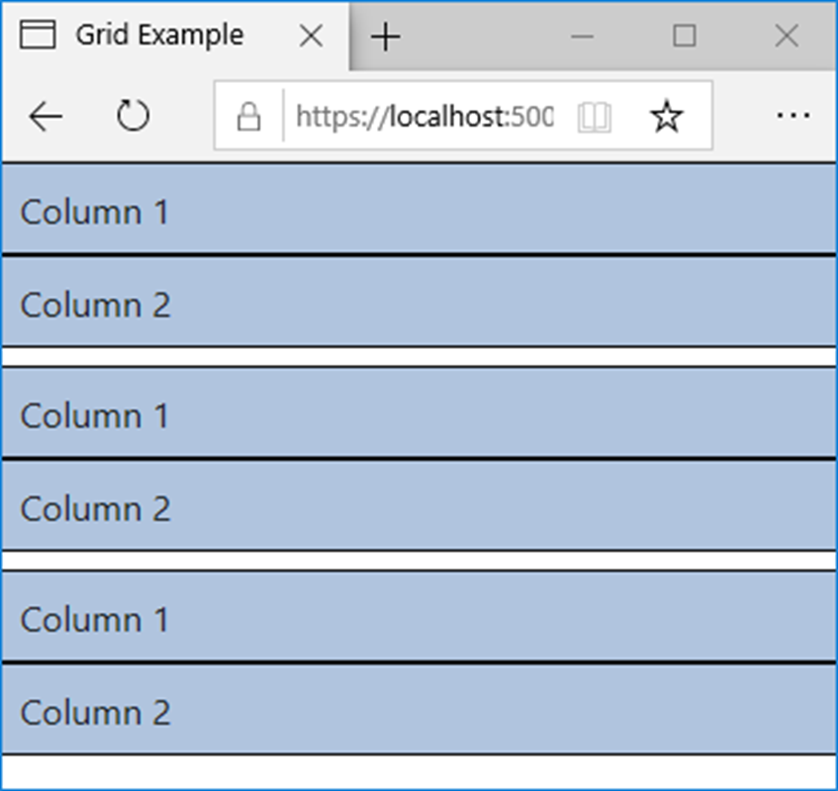
The Bootstrap grid on an extra small screen

Slide 20
Two Bootstrap CSS classes for forms
form-group
form-control

Slide 21
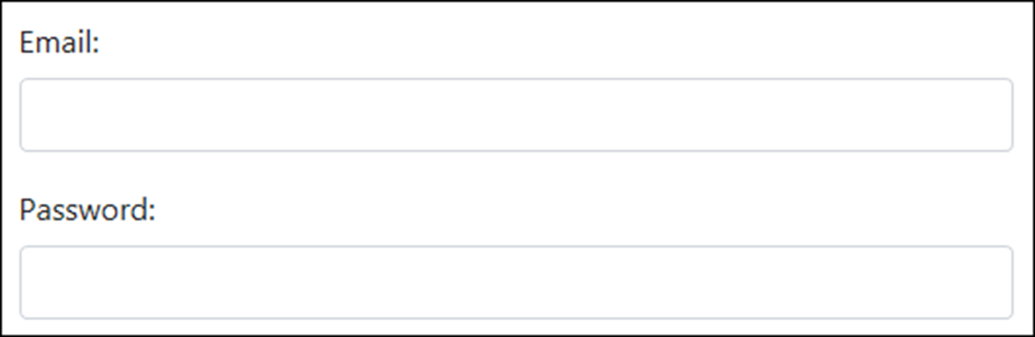
A form with two text boxes in vertical layout

Slide 22
The HTML for the form in vertical layout
<form asp-action="Login" method="post">
<div class="form-group">
<label for="email">Email:</label>
<input type="email" id="email" class="form-control" />
</div>
<div class="form-group">
<label for="pwd">Password:</label>
<input id="pwd" type="password" class="form-control" />
</div>
</form>

Slide 23
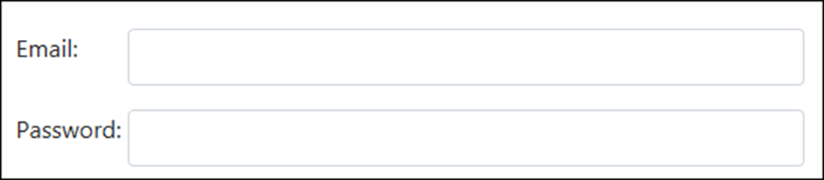
A form with two text boxes in horizontal layout

Slide 24
The HTML for the form in horizontal layout
<form asp-action="Login" method="post">
<div class="form-group row">
<label for="email" class="col-sm-2">Email:</label>
<div class="col-sm-10">
<input type="email" id="email" class="form-control" />
</div>
</div>
<div class="form-group row">
<label for="pwd" class="col-sm-2">Password:</label>
<div class="col-sm-10">
<input type="password" id="pwd" class="form-control" />
</div>
</div>
</form>

Slide 25
Bootstrap CSS classes for working with buttons
btn
btn-primary
btn-secondary
btn-outline-primary
btn-outline-secondary
Bootstrap CSS classes for working with images
img-fluid
rounded
A Bootstrap CSS class for creating a jumbotron
jumbotron

Slide 26
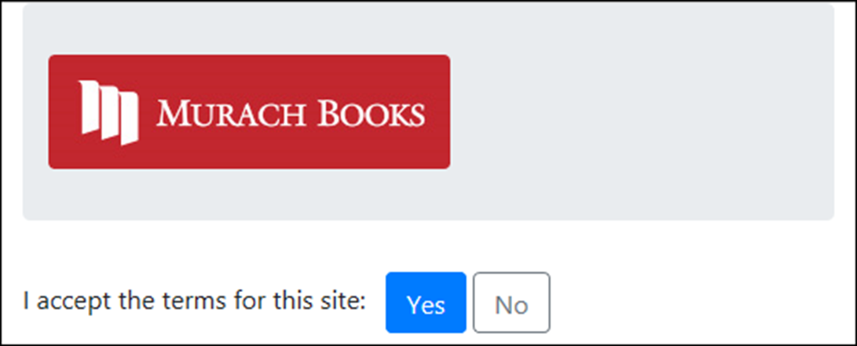
A jumbotron, an image, and two buttons

Slide 27
The HTML for the jumbotron, image, and buttons
<div class="container">
<header class="jumbotron">
<img id="logo" alt="Murach logo"
src="~/images/MurachLogo.jpg"
class="img-fluid rounded" />
</header>
<main>
<form asp-action="Index" method="post">
<span class="mr-2">I accept the terms for this site:
</span>
<button type="submit" class="btn btn-primary">
Yes
</button>
<button id="btnNo" class="btn btn-outline-secondary">
No
</button>
</form>
</main>
</div>

Slide 28
Bootstrap CSS classes for working with margins
mt-size
mr-size
mb-size
ml-size
m-size
Bootstrap CSS classes for working with padding
pt-size
pr-size
pb-size
pl-size
p-size

Slide 29
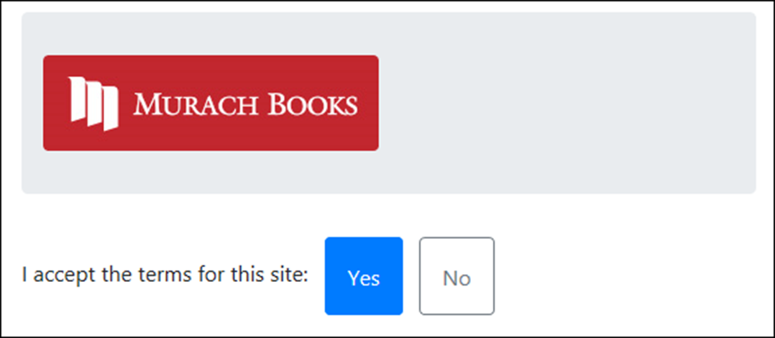
Some elements that use margins and padding

Slide 30
The HTML for the elements
<div class="container">
<header class="jumbotron mt-2">
<img id="logo" alt="Murach logo"
src="~/images/MurachLogo.jpg"
class="img-fluid rounded" />
</header>
<main>
<form asp-action="Index" method="post">
<span class="mr-2">
I accept the terms for this site:
</span>
<button type="submit"
class="btn btn-primary p-3 mr-2">Yes
</button>
<button id="btnNo"
class="btn btn-outline-secondary p-3">No
</button>
</form>
</main>
</div>

Slide 31
The code for the Index view (part 1)
@model FutureValueModel
@{
ViewBag.Title = "Future Value Calculator";
}
<div class="container">
<header class="jumbotron">
<img id="logo" alt="Murach logo"
src="~/images/MurachLogo.jpg"
class="img-responsive rounded" />
<h1 class="mt-3">@ViewBag.Title</h1>
</header>
<main>
<form asp-action="Index" method="post">
<div class="row form-group">
<label asp-for="MonthlyInvestment"
class="col-sm-3">Monthly Investment: </label>
<div class="col-sm-3">
<input asp-for="MonthlyInvestment"
class="form-control" />
</div>
<span asp-validation-for="MonthlyInvestment"
class="col text-danger"></span>
</div>

Slide 32
The code for the Index view (part 2)
<div class="row form-group">
<label asp-for="YearlyInterestRate"
class="col-sm-3">Yearly Interest Rate:
</label>
<div class="col-sm-3">
<input asp-for="YearlyInterestRate"
class="form-control" />
</div>
<span asp-validation-for="YearlyInterestRate"
class="col text-danger"></span>
</div>
<div class="row form-group">
<label asp-for="Years" class="col-sm-3">
Number of Years: </label>
<div class="col-sm-3">
<input asp-for="Years" class="form-control" />
</div>
<span asp-validation-for="Years"
class="col text-danger"></span>
</div>

Slide 33
The code for the Index view (part 3)
<div class="row form-group">
<label class="col-sm-3">Future Value:</label>
<div class="col-sm-3">
<input value="@ViewBag.FutureValue" readonly
class="form-control" />
</div>
</div>
<div class="row form-group">
<div class="col offset-sm-3">
<button type="submit" class="btn btn-primary">
Calculate</button>
<a asp-action="Index"
class="btn btn-outline-secondary">Clear</a>
</div>
</div>
</form>
</main>
</div>

Slide 34
CSS classes for working with HTML tables
table
table-bordered
table-striped
table-hover
table-responsive
w-size

Slide 35
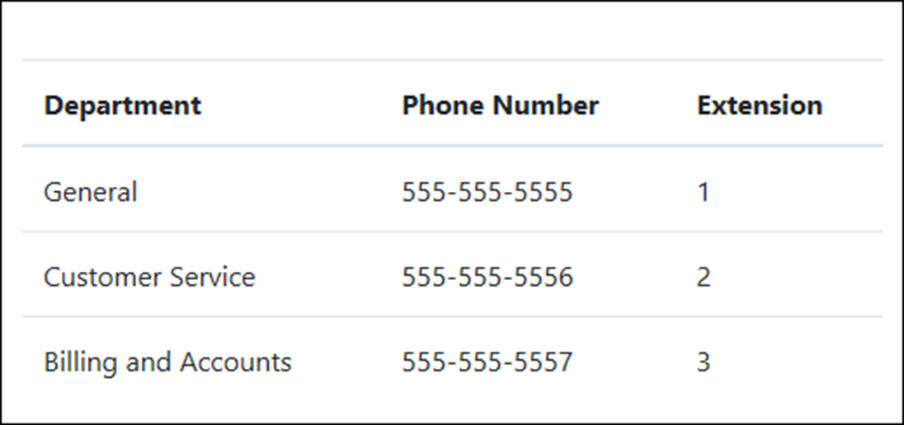
A table with default styling

Slide 36
The HTML for the table
<table class="table">
<thead>
<tr>
<th>Department</th>
<th>Phone Number</th>
<th>Extension</th></tr>
</thead>
<tbody>
<tr>
<td>General</td>
<td>555-555-5555</td>
<td>1</td></tr>
<tr>
<td>Customer Service</td>
<td>555-555-5556</td>
<td>2</td></tr>
<tr>
<td>Billing and Accounts</td>
<td>555-555-5557</td>
<td>3</td></tr>
</tbody>
</table>

Slide 37
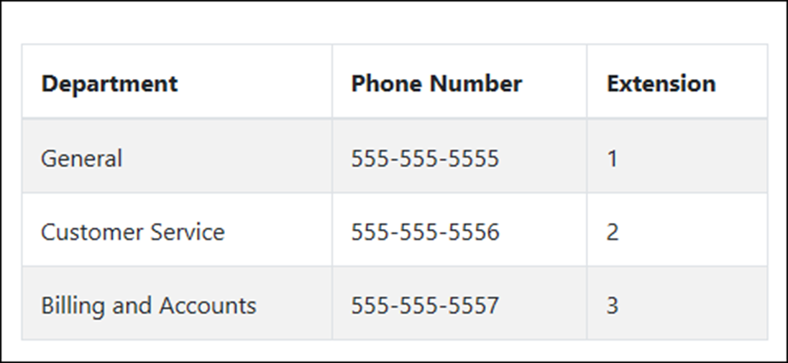
A table with alternating stripes and borders
The HTML for the table
<table class="table table-striped table-bordered table-hover">...

Slide 38
Common CSS classes for text
text-left
text-right
text-center
text-lowercase
text-uppercase
text-capitalize

Slide 39
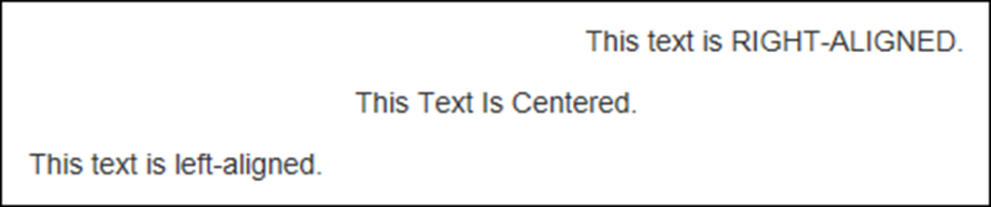
Some examples of the text CSS classes
The HTML for the text
<p class="text-right">
This text is <span class="text-uppercase">
right-aligned</span>.
</p>
<p class="text-center">
<span class="text-capitalize">This text is centered.
</span>
</p>
<p class="text-left">
This text is <span class="text-lowercase">
LEFT-ALIGNED</span>.
</p>

Slide 40
The context classes available to most elements
Class Default color
primary Dark blue
secondary Gray
success Green
info Light blue
warning Orange
danger Red
light White
dark Gray

Slide 41
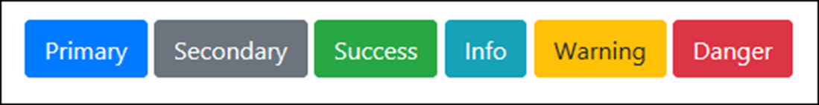
Some of the context classes applied to buttons
The HTML for the buttons
<button class="btn btn-primary">Primary</button>
<button class="btn btn-secondary">Secondary</button>
<button class="btn btn-success">Success</button>
<button class="btn btn-info">Info</button>
<button class="btn btn-warning">Warning</button>
<button class="btn btn-danger">Danger</button>

Slide 42
The success class applied to the text of an element
The HTML for the element
<p class="text-success">
Congratulations! You are now registered.
</p>

Slide 43

The warning class applied to the background of an element
The HTML for the element
<p class="bg-warning p-2 rounded">
Warning! Some required fields are empty.
</p>

Slide 44
Common CSS classes for creating button groups
btn-group
btn-toolbar
btn-group-size
btn-group-vertical

Slide 45
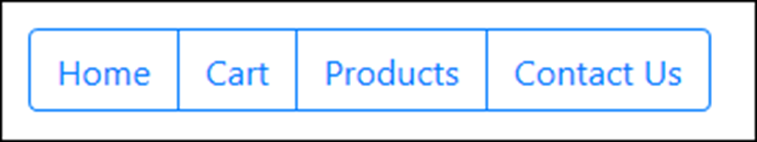
A basic button group
The HTML for the button group
<div class="btn-group" role="group"
aria-label="Button group">
<a href="/" class="btn btn-outline-primary">Home</a>
<a href="/cart" class="btn btn-outline-primary">
Cart</a>
<a href="/products" class="btn btn-outline-primary">
Products</a>
<a href="/contact-us" class="btn btn-outline-primary">
Contact Us</a>
</div>

Slide 46

A toolbar with two button groups
The HTML for the button groups
<div class="btn-toolbar" role="toolbar"
aria-label="Toolbar with groups">
<div class="btn-group mr-2" role="group"
aria-label="First group">
<a href="/" class="btn btn-outline-primary">Home</a>
<a href="/Cart" class="btn btn-outline-primary">Cart</a>
</div>
<div class="btn-group" role="group" aria-label="Second group">
<a href="/products" class="btn btn-outline-primary">
Products</a>
<a href="/contact-us" class="btn btn-outline-primary">
Contact Us</a>
</div>
</div>

Slide 47
The URL for the Font Awesome website
https://fontawesome.com/
A typical <link> element that enables Font Awesome icons
<link rel="stylesheet"
href="https://use.fontawesome.com/releases/v5.8.1/css/all.css"
integrity="sha-long-hash_code" crossorigin="anonymous">

Slide 48

A button group that includes icons for its buttons
The HTML for the button group
<div class="btn-group" role="group"
aria-label="Button group">
<a href="/" class="btn btn-outline-primary">
<span class="fas fa-home"></span>&nbsp;Home&nbsp;
</a>
<a href="/cart" class="btn btn-outline-primary">
<span class="fas fa-shopping-cart"></span>
&nbsp;Cart&nbsp;
</a>
</div>

Slide 49
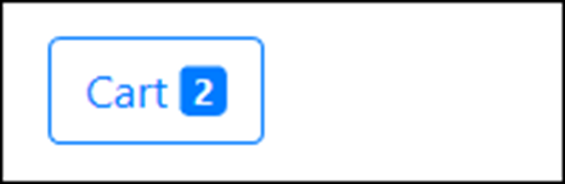
A button with a badge
The HTML for the button
<a href="/cart" class="btn btn-outline-primary">
&nbsp;Cart&nbsp;
<span class="badge badge-primary">2</span>
</a>

Slide 50

A button with an icon and a badge
The HTML for the button
<a href="/cart" class="btn btn-outline-primary">
<span class="fas fa-shopping-cart">
</span>&nbsp;Cart&nbsp;
<span class="badge badge-primary">2</span>
</a>

Slide 51
CSS classes for creating button dropdowns
dropdown
dropdown-toggle
dropdown-menu
dropdown-item
dropup
An HTML5 data attribute for creating button dropdowns
data-toggle

Slide 52
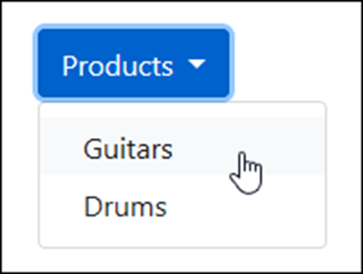
A button dropdown
The HTML for the button dropdown
<div class="dropdown">
<button type="button" class="btn btn-primary dropdown-toggle"
id="productsDropdown" data-toggle="dropdown"
aria-haspopup="true" aria-expanded="false">Products
</button>
<div class="dropdown-menu" aria-labelledby="productsDropdown">
<a class="dropdown-item"
href="/product/list/guitars">Guitars</a>
<a class="dropdown-item"
href="/product/list/drums">Drums</a>
</div>
</div>

Slide 53
Common CSS classes for creating list groups
list-group
list-group-item
active
disabled

Slide 54
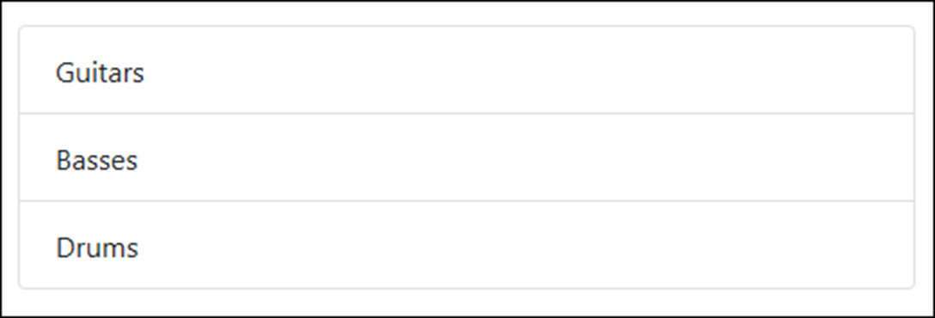
A basic list group
The HTML for the list group
<ul class="list-group">
<li class="list-group-item">Guitars</li>
<li class="list-group-item">Basses</li>
<li class="list-group-item">Drums</li>
</ul>

Slide 55
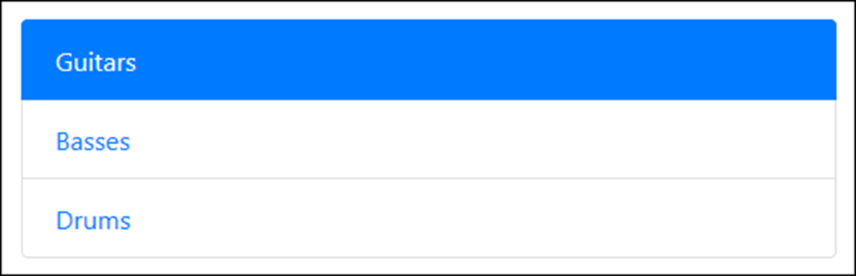
Another basic list group with an active item
The HTML for the list group
<div class="list-group">
<a href="/guitars" class="list-group-item active">
Guitars</a>
<a href="/basses" class="list-group-item">Basses</a>
<a href="/drums" class="list-group-item">Drums</a>
</div>

Slide 56
Common CSS classes for creating alerts
alert
alert-context
alert-dismissible
alert-link
close
An HTML5 data attribute for creating alerts
data-dismiss

Slide 57
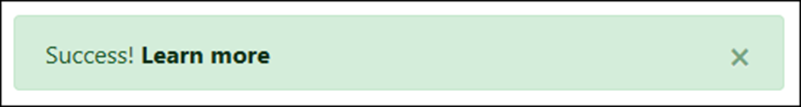
A dismissible alert with a link
The HTML for the alert
<div class="alert alert-success alert-dismissible">
<button class="close" data-dismiss="alert">
&times;
</button>
Success! <a href="#" class="alert-link">
Learn more</a>
</div>

Slide 58
Common CSS classes for creating breadcrumbs
breadcrumb
breadcrumb-item
active

Slide 59
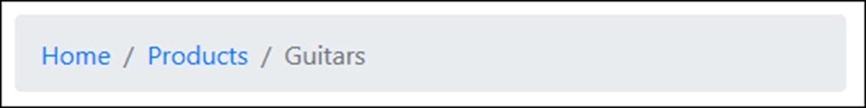
A breadcrumb with three segments
The HTML for the breadcrumb
<nav aria-label="breadcrumb">
<ol class="breadcrumb">
<li class="breadcrumb-item">
<a href="/">Home</a>
</li>
<li class="breadcrumb-item">
<a href="/Products">Products</a>
</li>
<li class="breadcrumb-item active"
aria-current="page">Guitars
</li>
</ol>
</nav>

Slide 60
Common CSS classes for creating navs
nav
nav-tabs
nav-pills
nav-item
nav-link
active

Slide 61
Nav links styled as tabs
The HTML for the nav links
<nav class="nav nav-tabs">
<a class="nav-item nav-link active" href="/">Home</a>
<a class="nav-item nav-link" href="/products">
Products</a>
<a class="nav-item nav-link" href="/cart">Cart</a>
</nav>

Slide 62
The same nav links styled as pills
The HTML for the nav links
<nav class="nav nav-pills">
<a class="nav-item nav-link active" href="/">Home</a>
<a class="nav-item nav-link" href="/products">
Products</a>
<a class="nav-item nav-link" href="/cart">Cart</a>
</nav>

Slide 63
A more verbose way of coding the same nav links
<ul class="nav nav-pills">
<li class="nav-item">
<a class="nav-link active" href="/">Home</a>
</li>
<li class="nav-item">
<a class="nav-link" href="/products">Products</a>
</li>
<li class="nav-item">
<a class="nav-link" href="/cart">Cart</a>
</li>
</ul>

Slide 64
Common CSS classes for creating navbars
navbar
navbar-expand-size
navbar-light-or-dark
navbar-brand
navbar-toggler
navbar-collapse
collapse
navbar-nav
navbar-alignment
HTML5 data attributes for creating navbars
data-toggle
data-target

Slide 65
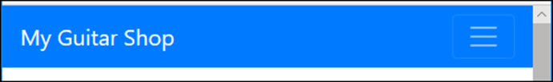
A navbar expanded on a wide screen
A navbar expanded on a small screen

Slide 66
The HTML for the navbar (part 1)
<nav class="navbar navbar-expand-md navbar-dark bg-primary">
<a class="navbar-brand" href="/">My Guitar Shop</a>
<button class="navbar-toggler" type="button"
data-toggle="collapse"
data-target="#navbarSupportedContent"
aria-controls="navbarSupportedContent"
aria-expanded="false"
aria-label="Toggle navigation">
<span class="navbar-toggler-icon"></span>
</button>
<nav class="collapse navbar-collapse"
id="navbarSupportedContent">
<div class="navbar-nav mr-auto">
<a class="nav-item nav-link active" href="/">Home</a>
<a class="nav-item nav-link"
href="/products">Products</a>
<a class="nav-item nav-link" href="/about">About</a>
</div>

Slide 67
The HTML for the navbar (part 2)
<div class="navbar-nav navbar-right">
<a class="nav-item nav-link" href="/cart">
<span class="fas fa-shopping-cart"></span>
&nbsp;Cart&nbsp;
<span class="badge badge-primary">2</span>
</a>
</div>
</nav>
</nav>

Slide 68
More CSS classes for positioning navbars
fixed-top
fixed-bottom

Slide 69
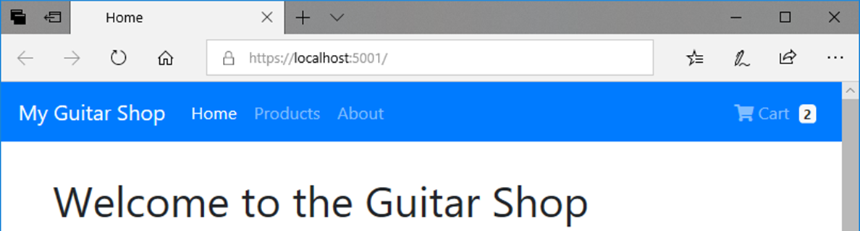
A navbar that’s fixed at the top of the screen

Slide 70
The HTML that displays the navbar
<body>
<nav class="navbar navbar-expand-md navbar-dark
bg-primary fixed-top">
<!-- navbar items go here -->
</nav>
<div class="container">
<!-- container items go here -->
</div>
</body>
The CSS that sets the top margin
body {
margin-top: 70px;
}

Slide 71
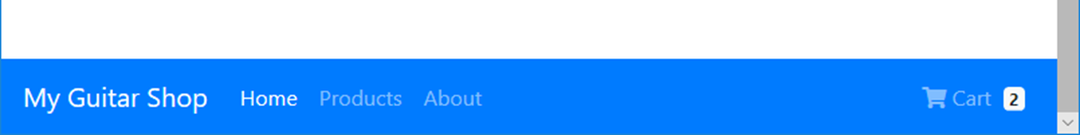
A navbar that’s fixed at the bottom of the screen

